Slide 1

Telco churn prediction model
Peerapat.t, Data scientist
…@gmail.com, github.com/

Slide 2
Table of content
1. Business problem
Cost of acquiring a new customer
Why does churn prediction matter?
2. How to solve this problem
Do nothing
Retain all customers
Use a churn prediction model
3. Data
Target
Features
3. Solution
Churn prediction model performance
Promotion/campaign to retain customers
Use of model in the future
4. Model
Data understanding
Technique used
Model evaluation
Feature importance
Future work
References
Author

Slide 3
1. Business problem
1.1 Cost of acquiring a new customer
The cost of retaining a customer is typically much lower than the cost of acquiring a new customer.
For example, a study by Bain & Company found that it costs 5 to 7 times more to acquire a new customer than it does to retain an existing customer.
This is because existing customers are already familiar with your product or service and they are more likely to continue doing business with you.
1.2 Why does churn prediction matter?
Churn prediction can help businesses identify customers who are at risk of leaving.
This allows businesses to take action to retain those customers, such as offering them discounts or special promotions.
Churn prediction can also help businesses to identify trends in customer behavior that may lead to churn, so that they can address those issues before they cause customers to leave.

Slide 4
2. How to solve this problem
2.1 Do nothing
Business not take any action to retain customers.
2.2 Retain all customers
Business take action to retain every customer.
2.3 Use a churn prediction model
Business use churn prediction to predicts who are at risk of churning.
Option | Cost | Effectiveness
Do nothing | Least expensive | Least effective
Retain all customers | Most expensive | Most effective
Use a churn prediction model | More cost-effective than retaining all customers | More effective than doing nothing

Slide 5
3. Data
3.1 Target
There are 7,032 customers in the dataset, including churn and not-churn customers.
Churn customers are those who have unsubscribed within the last month.
Customer account information: This includes how long they've been a customer, contract, payment method, paperless billing, monthly charges, and total charges.
Demographic info about customers: This includes gender, age range, and if they have partners and dependents.
3.2 Features
The dataset contains 22 features, which can be categorized into four groups:
Services that each customer has signed up for: This includes phone, multiple lines, internet, online security, online backup, device protection, tech support, and streaming TV and movies.

Slide 6
4. Solution
4.1 Churn prediction model performance
Option | Total (Test) | Actually churn | Overspend (FP) | Save (TP) | Gains (or Loss)
Do nothing | 1,407 | 374 | 0 | 0 | -187,000
Retain all | 1,407 | 374 | 1,033 | 374 | 83,700
Churn prediction model | 1,407 | 374 | 307 | 295 | 110,700
Utilizing churn prediction results in a cost savings of 3.38X compared to the 'do nothing' program and 0.32X compared to the 'retain all' program.
Costs are calculated under the assumption that acquiring new customers costs 5X more than retaining existing customers."

Slide 7
4. Solution
4.2 Promotion/campaign to retain customers
Rewards: Launch a loyalty rewards program with points for every action, redeemable for discounts and upgrades.
Upgrade: Limited-time offers for plan and device upgrades with special incentives.
Refer & Earn: Incentivize referrals with rewards for both referrers and new customers.
Data Week: Offer free data upgrades for a week to enhance connectivity.
Community Connect: Engage customers in community service, rewarding them with discounts and donations.
4.3 Use of model in the future
Predict customer who are at risk to churn in the next month using the model and send leads to marketing team for retention campaign.
Train/Val
Test
Prediction
202201-202212
202301
202302-

Slide 8
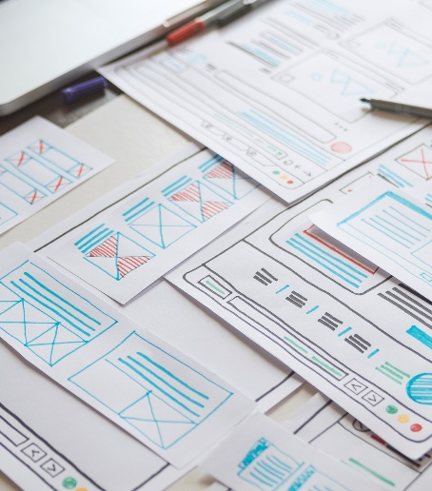
End of business session

Slide 9
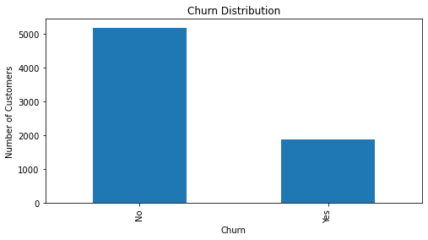
4. Model
4.1 Data understanding
If we look at the target distribution, we can see that the data is imbalanced.
In such scenarios, relying solely on metrics like accuracy can be misleading and ineffective. Instead, it is essential to explore alternative evaluation measures, such as precision, recall, F1-score, or area under the precision-recall curve (AUC-PR), which provide a more accurate result.
Resampling method or threshold tuning should be applied to handle this problem.

Slide 10
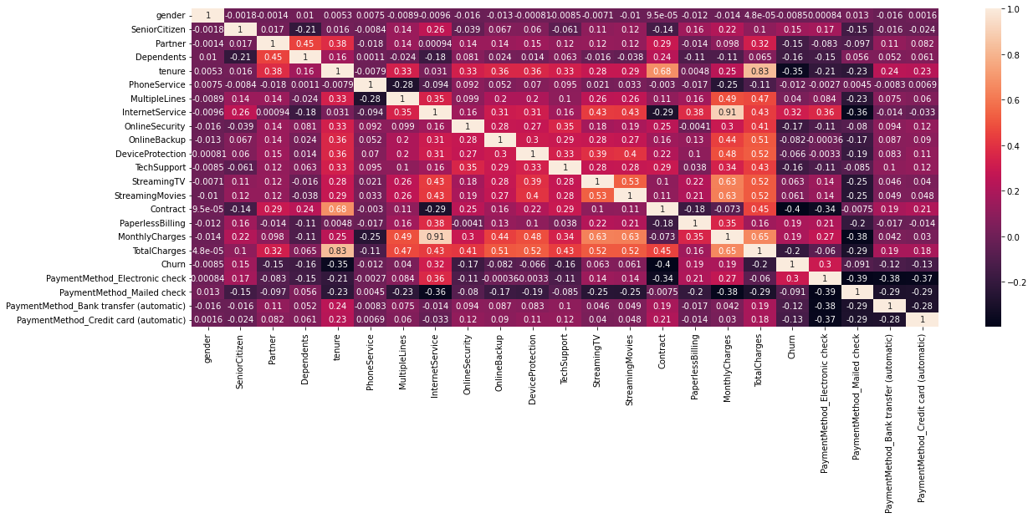
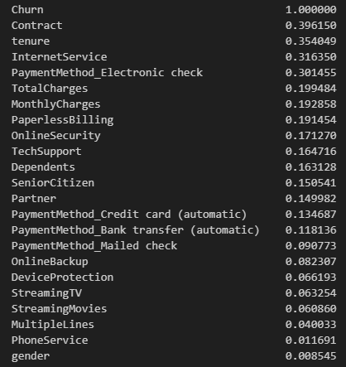
4. Model
4.1 Data understanding (cont.)
More than 15 features exhibit a high correlation (greater than 0.3 in absolute terms) with the target variable.

Slide 11
4. Model
4.2 Technique used
Step | Topic | Cost
1 | Dataset | Split the data into train, test, and validation sets. Use the train set to train the model, the validation set to tune the threshold, and the test set to evaluate the model.
2 | Normalized | Use Min-Max scaling to normalize the data.
3 | Resampling | Try oversampling (SMOTE) and undersampling (random undersampling).
4 | Model | Try random forest, LightGBM, and XGBoost.
5 | Hyperparameter tuning | Use RandomizedCV to find the best hyperparameters for each model.
6 | Threshold tuning | Use cost-sensitive learning to tune the threshold. Assign a cost of 5 times more to acquiring new customers than to retaining existing customers.
7 | Interpreting | Use SHAP values.

Slide 12
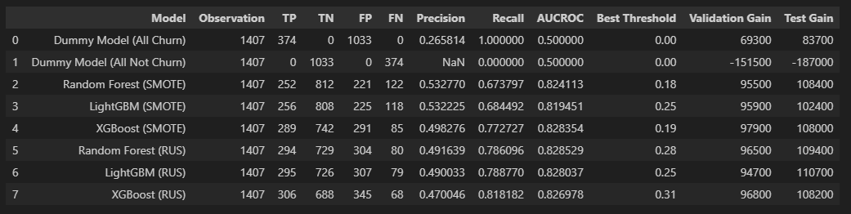
4. Model
4.3 Model evaluation
Before performing threshold tuning, XGBoost (RUS) seems good because it has a high AUCROC and the highest Recall.
However, prior to that, LightGBM (RUS) is the better model as it achieves maximum gains.
Ultimately, for the final decision, we choose LightGBM (RUS) to deploy in our system."

Slide 13
4. Model
4.4 Feature importance
Features | Sign | Meaning
Contract | + | Customers on contract packages are more prone to switching due to enticing promotions from other operators, offering benefits like data roaming. In contrast, top-up package users, who primarily make calls, show lower inclination to switch.
Tenure | + | Customers who have been with us for a long time have a higher probability of churning. This might be because they are more likely to be older and more hesitant to cancel our service.
Monthly charges | - | Customers who pay lower charges may have a higher probability of churning. This is because the industry's current trend offers attractive low-priced packages for new customers, possibly causing them to cancel and apply with other operators.
Internet service | - | Customers without internet included in their package are more likely to churn. In today's context, internet has become a crucial factor, leading customers to cancel our package in favor of competitors offering inclusive internet services.
Payment method (electronic check) | - | Customers who do not use electronic payment methods may be more inclined to churn. This aligns with the tenure-related churn reason, indicating that older customers may decide to cancel our service.

Slide 14
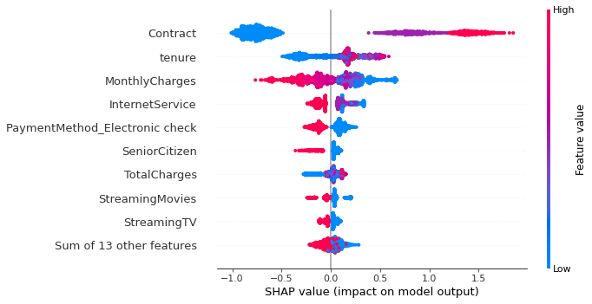
4. Model
4.4 Feature importance (cont.)

Slide 15
5. Future work
Improve model performance by creating more features and performing feature engineering.
Experiment with different machine learning models, such as SVC and deep learning.
Tune hyperparameters using sequential search techniques, such as Optuna.
Segment customers using clustering and retain them with personalized promotions.

Slide 16
End of this presentation

Slide 17


6. About me
A
B
C
D
Contact me on
Linkin.com/
Github.com/

